Slide 1
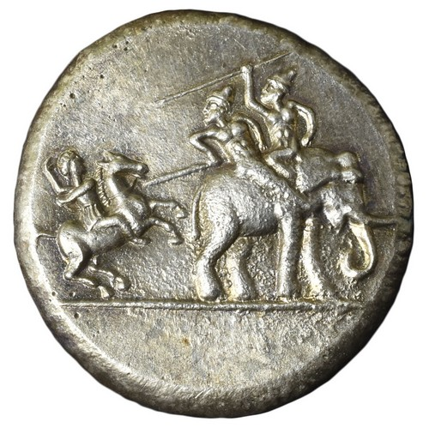
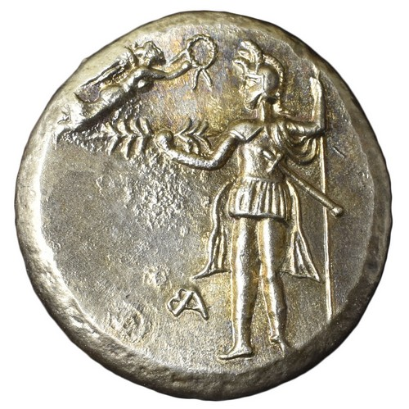
Week 4B: The Indian Campaign; The Battle of the Hydaspes; “Mutiny” at the Hyphasis (327-326 BCE)
The ‘Elephant Medallion’; decadrachm minted at Babylon c.324 BCE

Slide 2
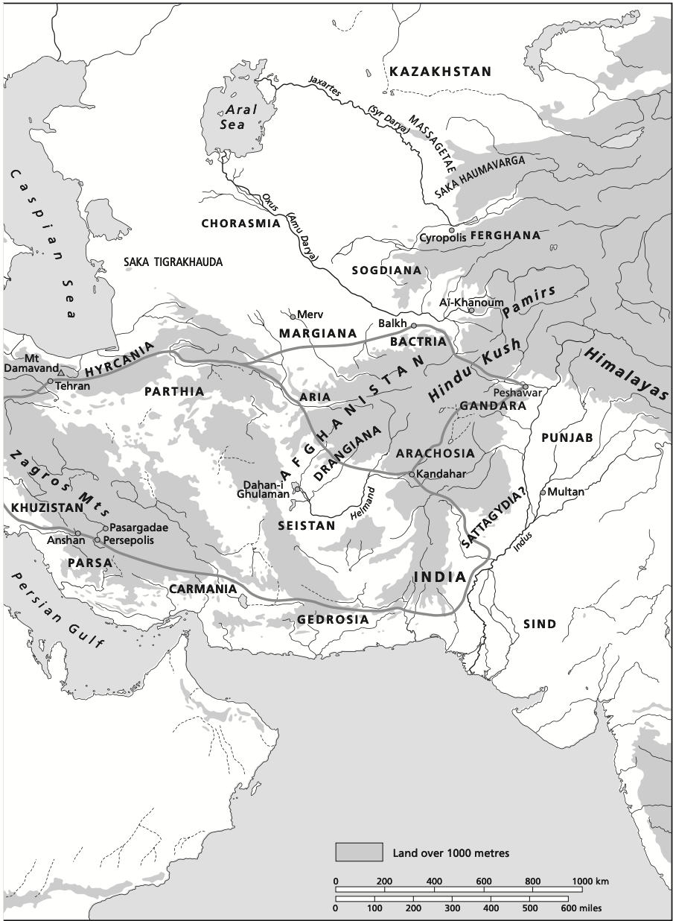

Slide 3
Where We Left Off:
*Bactria/Sogdiana pacified over 329-327:
Irregular Warfare; Mountain warfare
Securing Existing satrapies but also frontier regions
A Marked increase in punitive tactics on the part of Alexander
The resistance came from provinces that were well integrated in Achaemenid empire, with allies from beyond
*Flare-ups of discontent and suppression of (perceived) threats:
Philotas and Parmenion
Cleitus the Black
Conspiracy of the Pages
Callisthenes
*As Alexander marched out of Bactra in early summer of 327, his stated goal was the conquest of India (not to be confused with the very large modern nation); unlike in the previous years, the campaign involved confrontation with local rulers (SE of the Hindu Kush) who were either recently independent from, or never a part of, the Achaemenid empire.
*Some Indian rulers, notably Taxiles (territory on the east bank of the Indus), had already approached Alexander with offers of alliance while he was in the north (Diodorus 17.86).

Slide 4
The March to the Indus River
*After re-crossing the Hindu Kush, the first resistance was found in the (former) satrapy of Gandhara (the region around Peshawar).
*There is no evidence that there had been a Persian satrap in the region at this time; it had been under Persian control in the time of Darius I, but was almost certainly independent at the time of A.’s arrival (but note Persian influence in the Indian contingents sent to Gaugamela).
*After departing from Alexandria in the Caucasus (modern Bagram), Alexander split the army into two columns:
One under Hephaestion and Perdiccas took the Kyber pass to the city of Peucelaotis (mod. Charsadda), securing the main road into the region.
The other half with Alexander (notably the more mobile hypaspists and Agrianians) stuck to the mountains north of the Kabul river. Resistance in the region from the Aspasians and then the Assacenians, using mountain hideaways and fortified cities.
*Bosworth (Alexander and the East, pg. 26): “The act of killing meant little, and it can be shown that the level of violence escalated as a direct response to resistance during the grim campaigns in the north-east and India… The frightfulness increased as he moved on India. Massacre and enslavement was the policy against settlements which stood siege…”

Slide 5
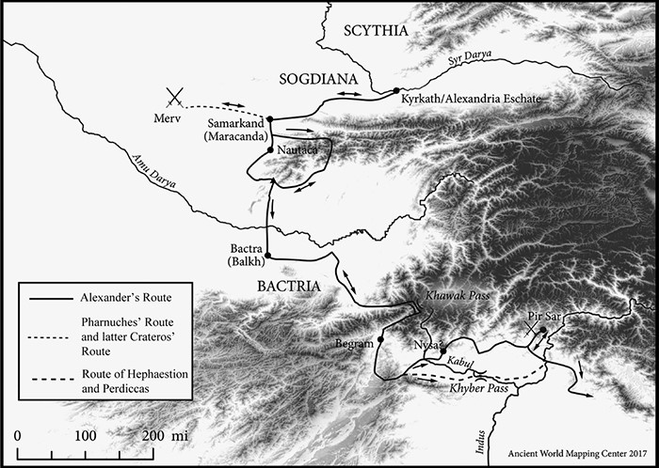

Map of Central Asia and route to Indus (Heckel 2020)
Notes:
Map 11.1 Map of Central Asia and route to Indus.
Unless provided in the caption above, the following copyright applies to the content of this slide: In the Path of Conquest. Waldemar Heckel, Oxford University Press (2020). © Oxford University Press. DOI: 10.1093/oso/9780190076689.001.0001

Slide 6
*There was no central power co-ordinating resistance to Alexander: each local ruler (hyparch, in Arrian) and city had to be dealt with individually, with some resisting and others seeing A.’s ruthlessness and submitting.
*The force under Hephaestion and Perdiccas was instructed to make their way to the Indus and prepare a boat bridge for the river crossing, alongside Taxiles and other local leaders. The leader in Peucelaotis, a certain Astis, resisted and was besieged for 30 days.
*Alexander, meanwhile, made a terrible example of the first city to resist: A. was lightly wounded, and after taking the city, the Macedonians killed all those who were fleeing, finally burning the city to the ground.
*The next city, Andaca, surrendered; Craterus appointed to deal with any neighboring cities showing resistance.
*Next to a city (the name is lost), “where the hyparch of the Aspasians was” (Arrian 4.24.1); but instead of defending the city, the inhabitants burned it and retreated to the mountains, where A. hunted down anyone fleeing.
*Arrian (4.24.3-5) reports that Ptolemy risked death to kill the leader of the Aspasians.

Slide 7
*Next, another city (Arigaeum) is burned in retreat. Alexander deemed the site ideal for a settlement, and had it fortified and settlers brought in from surrounding areas (Arrian 4.24.7)
-> Note the recurring strategy: garrison, settlement, control of restless areas
*A. pursues the remaining Aspasians into the hills. Ptolemy reports 40,000 men captured after fierce fighting (unlikely).
*A first glimpse of Alexander the ‘explorer’, ‘natural historian’: thousands of oxen seized, and given their impressive size, examples sent back to Macedonia.
*After the Aspasians came the Assacenians: more running to the hills, siege of the principal city of Massaga -> eventual surrender with offer to join A.’s army -> Arrian (4.27.4) reports that the surrendered fighters planned to slip away in the night and were massacred.
*After another siege, the inhabitants of Bazira fled their city to the mountain top called Aornos in our Greek sources…

Slide 8
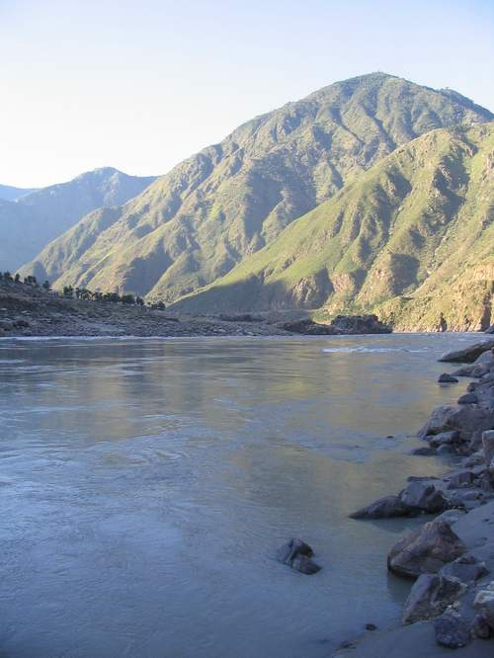
The Siege of the Birdless Rock (Spring 326)
Aornos (Greek “birdless”), probably corresponding with the modern Pir Sar mountain, perhaps a rendering of the Old Indian Avarana “hiding place”.
* Arrian (4.28) reports that it was believed that Herakles failed
to storm this mountain (he is skeptical); but upon learning this,
“a longing seized” Alexander to take the mountain-top fortress.
* The mountain was associated in local legend with the Hindu
deity Krishna (=Herakles?).
* First he fortifies several captured cities as forts, and appoints a
satrap, Nicanor, over the region west of the Indus river.
* Arrian (4.29) says Ptolemy was given a command to seize a key
position with the help of local guides (absent from other sources)
*Arrian: brave and brilliant siege tactics, several days hard fighting
Diodorus (17.85): a much shorter version, no Ptolemy.
* After neutralizing resistance centered on Aornos, A. was able to take control of the Assacenian territories.

Slide 9
Nysa
* Treated by Arrian (5.1) outside of the chronological sequence: a showpiece to begin Book 5?
Plutarch (58) only treats a brief anecdote from the Nysan embassy to A. (a certain Acouphis), no Dionysus story
* Alexander arrives at the city called Nysa, which was supposed to have been founded by Dionysus after his conquest of India (an ‘agnostic’ approach from Arrian 5.1.2).
* The Nysan ambassador begs A. to spare the city on the grounds of its holy associations, and A. is pleased with the idea of going farther than Dionysus had -> Many aspects of Nysa represented as Greek: Dionysus, Aristocratic government, “independence” (eleutheria), rhetorical persuasion of the ambassador.
Arrian (5.2.1): “He thought that the Macedonians would not be so reluctant to follow him on arduous campaigns still further on if they were spurred on by the ambition to surpass Dionysus’ achievements.”
*We should keep this episode in mind when we turn to the end of the line at the Hyphasis river: Arrian particularly insistent on Alexander’s desires to push further and further.

Slide 10
A Digression on “India”
Arrian (5.4.3): “In this history I have deliberately omitted any account of the customs and institutions of the Indians, of any strange fauna their country produces, of the size and nature of the fish or other monsters found in the Indus, Hydaspes, Ganges, or other Indian rivers, of the ants that mine their gold or the griffins that guard it, or of all the other fabrications people have made up as sensational stories rather than descriptions of reality, in the certainty that no one was likely to disprove any far-fetched falsehood peddled about India and the Indians.”
-> Arrian does often depict Alexander the explorer (e.g. 6.1.2, A. believes he has discovered the source of the Nile river because of crocodiles in the Indus).
Richard Stoneman, The Greek Experience of India: “Every age has had its own picture of India, always from the vantage point of an observer who finds what he observes essentially alien. Yet the otherness of India exerts a pull, a fascination, which naturally results in a particularly strong distortion of reality to fit what the observer thinks he sees, wishes to see, or believes he ought to see. In order to understand how Greeks such as Megasthenes saw India, it is necessary to peel back these curtains or at least to be aware of the distorting, pixillating effect each separate one has on our field of vision.”
Q) Where have you observed Stoneman’s “distorting, pixillating” effect in our primary source readings this week?

Slide 11
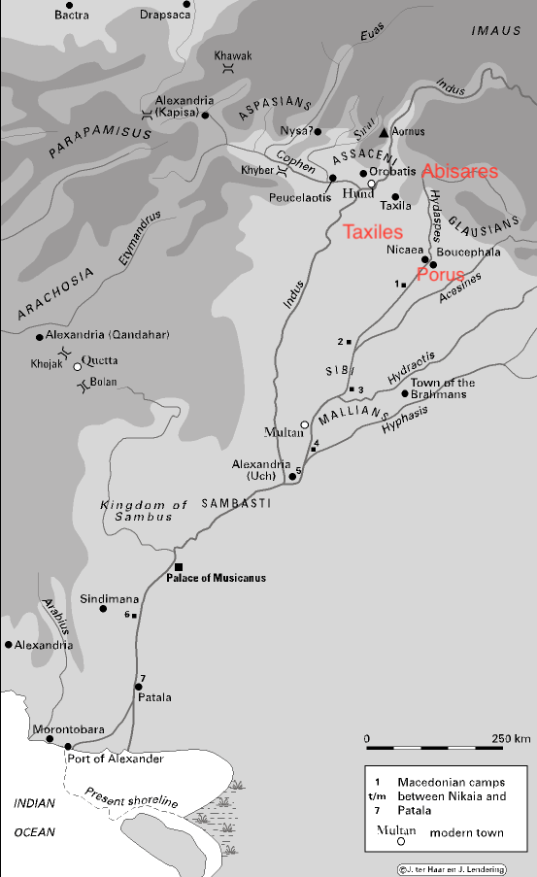

Slide 12
Taxiles and Porus
With the hill country secured, and after much violence there, A. made his way to the Indus river and crossed, by means of a boat bridge prepared in advance by Hephaestion and Perdiccas.
He was first met by the king Taxiles (actually soon-to-be, at the time a prince named Omphis); Taxiles brought lavish gifts and was confirmed as a vassal king by Alexander.
Taxiles must have had his principal enemies, Porus and Abisares in mind when he visited Alexander in Sogdiana.
Alexander did appoint a satrap over the new territory east of the Indus river, Philip, son of Machatas; it is not clear how the relationship between satrap and king would work, as this was a new approach.
From the city of Taxila, Alexander secured submission from Abisares via envoys, but Porus made clear that he would meet A. in battle, and had a large army waiting on the opposite banks of the Hydaspes (Jhelum) river.

Slide 13
The Battle of the Hydaspes (Late Spring 326)
The confrontation with Porus brought several challenges: the Hydaspes was a deep, fast-flowing river (esp. in summer), and Porus had a strong elephant division, the likes of which A. had not yet faced.
Alexander prepared by shipping the boat bridge from the Indus, and gave the impression that he was preparing to cross at low water in the autumn.
Arrian (5.10) describes how Alexander pretended to be making maneuvers every night, which Porus would track until finally becoming complacent with no attacks occurring.
The river crossing involved a series of diversions, and ultimately Alexander would face Porus’ army with only the elite troops that he took across himself. This must mean that the numbers in Porus’ army were (surprise!) exaggerated in our sources (Arrian 5.15.5: 4,000 cavalry, 300 chariots, 200 elephants, 30,000 infantry). Alexander’s actual fighting force was only 6,000 infantry and 5,000 cavalry.
But despite questions about Porus’ numbers, A.’s tactics were brilliantly executed, and the river crossing went unopposed, forcing Porus to back up his army into a defensive position.
Macedonian success still depended on a strategy for facing Porus’ elephants (whatever the number): the key lay in the long sarissa spears of the phalanx, which could dismount the drivers and send the elephants into a panic.

Slide 14
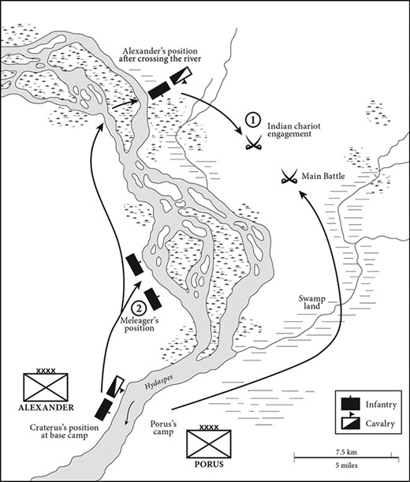

Slide 15
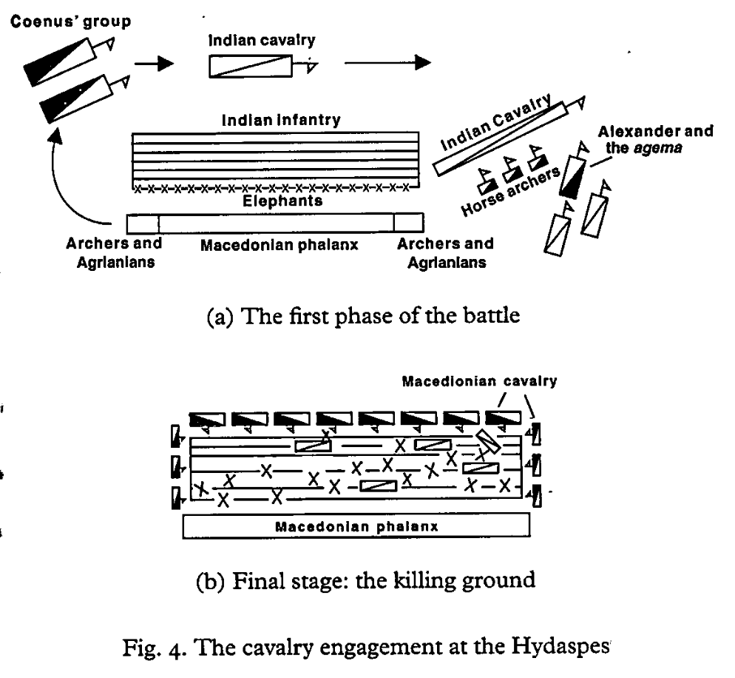
From Bosworth, Alexander and the East (pg. 17)

Slide 16
Porus
The aftermath of the battle is one of the famous episodes in Alexander’s campaign:
Arrian 5.18.4: “Porus had played a distinguished role in the battle, not only as commander-in-chief, but as a fine soldier… unlike the great king Darius he did not give way and start a general flight by his own example…”
Arrian 5.18.6: “Alexander dearly wanted to save the life of a great man he had seen fight a noble battle. So he first sent out Taxiles the Indian to reason with him. Taxiles rode up as close as he thought safe to the elephant carrying Porus, and asked him to halt the animal, as there was no escape, and listen to Alexander’s proposals. Seeing an old enemy in Taxiles, Porus made for him with javelin in hand: and he could well have killed him…”
Alexander sends several men to talk down Porus, finally succeeding with an old friend, who brought him to A.

Slide 17
Porus
Arrian 5.19: “He reined in his horse and gazed for a while at Porus, struck by the size of the man (he was over seven and a half feet tall), his handsome looks, and the way he seemed quite unbroken in spirit, more like one brave man meeting another after an honourable battle for his kingdom with another king. Alexander was the first to speak.
He asked Porus to say what he wished to be done with him, and Porus is said to have replied: “Treat me, Alexander, like a king”. Pleased with this answer, Alexander said “For myself, Porus, I shall do as you ask: tell me know now what you expect for yourself”. Porus replied that everything was contained in that one request. Yet more impressed by this answer, Alexander granted Porus continued rule over his Indian kingdom and added to its original extent further territory which more than doubled it. This was how he fulfilled his own commitment to treat a brave man “like a king”, and Porus’ response was complete loyalty thereafter.”
Plutarch (60) reports a shorter but similar version of the story, with less emphasis on the figure of Porus; he also makes clear that his expanded territory was included in Philip’s satrapy.
Q) So is Porus a king, or a vassal under a Macedonian satrap? Is Plutarch mistaken about the territory under Philip, or is Arrian exaggerating Porus’ continued kingship?
*In 325, Philip was assassinated (Arrian 6.27), and his satrapy was divided (provisionally) between Taxiles and Eudamas. But Arrian also says later that Philip’s territory was west of the Indus, and that Porus was announced king of all acquired Indian territory (6.2.3 ; 6.2.1).

Slide 18
Bucephalas (Bucephalus)
Shortly after the battle of the Hydaspes, Alexander’s horse Bucephalas died (Arrian 5.19.5-6; Plutarch 61) -> Alexander then founded two settlements on the Hydaspes, one named Nicaea (Nikaia) = “victory”, another named Bucephala (neither site has been found).
This is in fact Arrian’s only mention of Alexander’s famous horse, and here notes that nobody else could mount him (cf. Plutarch’s story of the young Alexander).
The Good Porus and the Bad Porus
Arrian’s account of the aftermath of the battle with Porus is unique: he is the only author to explicitly compare Porus and Darius III, suggesting a bigger meditation on kingship (Howe).
This becomes more clear when Arrian compares the first Porus, and another Porus, Πώρος ὁ κακός, “the bad Porus” (5.21). This “bad Porus” is said to have made offers of surrender to Alexander before the Hydaspes battle, but fled after A. and the “Good” Porus came to terms.
Only in Arrian does this “bad” Porus play such a large role, and it is Ptolemy who is crucial in defeating him. It is these pursuits that ultimately bring the army to the Hyphasis (Beas) river (also a bloody campaign against the Cathaeans, with the siege of Sangala, only documented at length in Arrian (5.23-24).

Slide 19
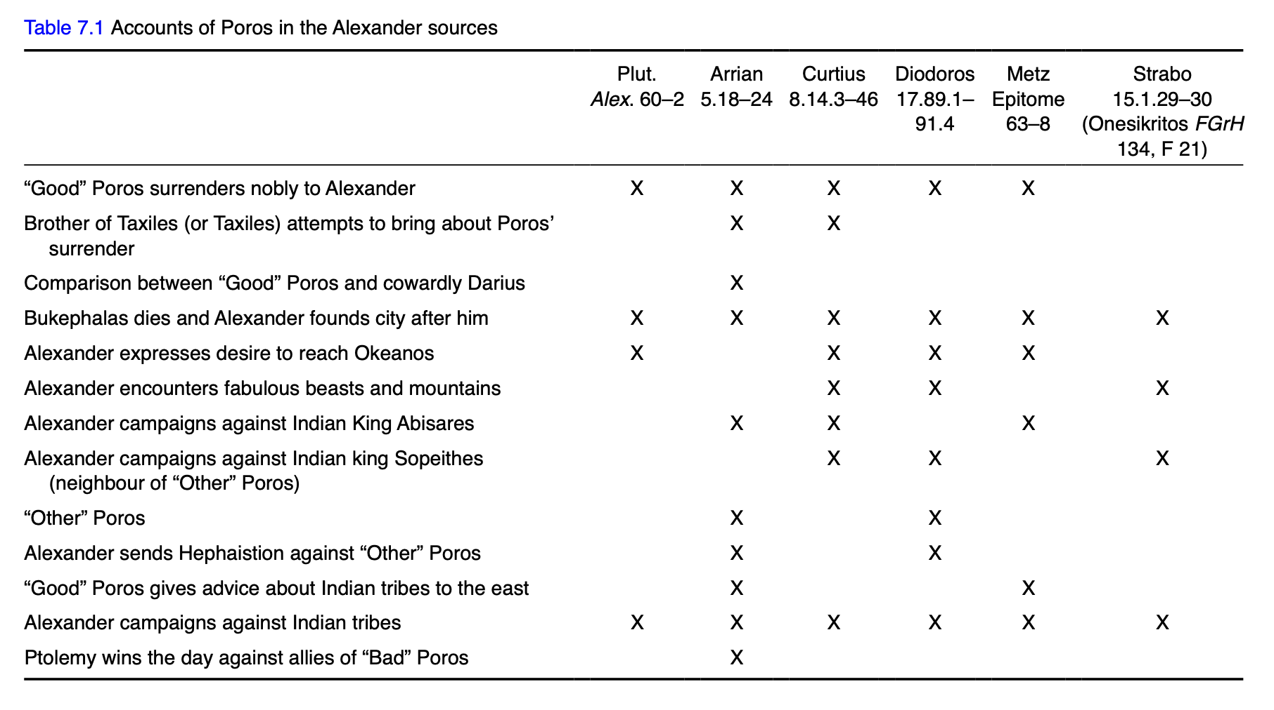

Slide 20
Issues
The ”Mystery of the Elephant Medallions” (Frank Holt)
Probably produced at Babylon under Mazaeus
Aristeia: awards for merit in military service
How does the imagery of the coins conflict with the accounts
of our sources?
What next? Alexander had now secured the previous borders of the Persian empire at the Indus, and established client kings beyond under a new, expanded, satrapy (?).
But at the partition of Babylon (323, after Alexander’s death), Taxiles and Porus held their expanded territories, not as satraps but as (vassal) kings.
What does Alexander’s response to resistance in the region say about his approach to empire-building? (cf. Sogdiana, another frontier region)
What distorting effects does the region of “India” have on our accounts? Can we peel back the layers of distortion to understand A.’s goals in the region?

Slide 21
The End of the Line
*Diodorus (17.89.5): “His plan was to get to the end of India, subduing all the inhabitants of the country on the way, and then to sail down to the Ocean.”
Statement comes after the defeat of Porus; ship-building on the Indus river(!)
Typically taken to refer to modern India, with an exit at the Bay of Bengal (distortion?)
Diodorus’ statement describes exactly what Alexander actually did!
*Arrian (5.25.2): “It was also reported that these Indians in the east (i.e. of the Hyphasis) had a far greater number of elephants than elsewhere in India, and that their elephants were distinguished for their great size and courage. These reports spurred in Alexander a desire to press on further. But the Macedonian’s spirits were flagging by now…”
This clearly refers to a campaign into modern India
Alexander then addresses his troops in a long speech in direct quotation (5.25.3-26.8), urging them on to this new phase of campaigning.
Coenus speaks on behalf of the troops, who applaud (5.27)
Ptolemy says that Alexander makes sacrifices on the Hyphasis, and they are inauspicious (5.28.4); after this Alexander concedes to end the campaign; 12 altars built on the Hyphasis.
*Plutarch (62): “Another consequence of this battle with Porus was that it blunted the edge of the Macedonians’ courage and made them determined not to advance any farther into India… At first, Alexander was so overcome with disappointment and anger that he shut himself up and lay in his tent.” (Plutarch confuses the Hyphasis and the Ganges, which doesn’t help!)

Slide 22
The End of the Line
W. Heckel,’ Alexander the Great and the ’limits of the world’ (pg. 166): “We need only look at Alexander’s own actions and preparations in order to see that the proposed invasion of India (i.e. modern India) was a sham. The clearest indications that Alexander believes he has completed the conquest of the Persian empire, and thus achieved his goal, are the sacrifices at the Hydaspes and the building of the Indus fleet. These are clearly spelled out in the popular tradition but Arrian’s account obscures Alexander’s true intentions somewhat, and I believe this obfuscation is deliberate.”
More Problems:
What did ancient writers even mean by “India”?
A. likely had no knowledge of the Indian subcontinent before meeting figures like Taxiles.
If he intended to march across the subcontinent to the eastern ocean, why leave vassal kings like Taxiles and Porus in his line of communications?
Arrian, despite being generally most reliable, still prone to hero worship… Alexander’s speech at the Hyphasis a cover story?
Wouldn’t it make more sense that Alexander was doing the exact same thing as in the upper satrapies? -> Pacify and secure restless provinces, create buffer zones beyond borders.
A campaign to the Ganges and beyond would take Alexander against a totally new empire (Nanda); indeed soon, under Chandragupta Maurya, a formidable empire would reconquer all of this territory.
Greek/Roman/Modern Historiography: Uncomfortable with Alexander, Great King, King of Kings?

Slide 23
The End of the Line
*This is what is commonly described as the “mutiny” at the Hyphasis river; even if Arrian’s account is not a pure fabrication, would this amount to mutiny?
*Do we trust Arrian and his carefully polished speeches? Or Diodorus and his matter of fact account?
- Diodorus does allude elsewhere to some of what is in Arrian: A. wanted to march against the Gandaridae ( 17.93.4) across the Ganges (Nanda empire), but knew it would be difficult; A. gave a speech to his men but failed to convince them (17.94).
*Ultimately, our understanding of this episode may come down to our own preconceptions about Alexander, and the distorting effect of subsequent colonial histories (esp. British empire).
*What do YOU think?

Slide 24
Going “Home”
*The end of the campaign of conquest was not quite at hand though, A. and his army worked their way down the river system, on the way facing resistance from several peoples, notably the Mallians and Oxydracae.
Winter 326/325: A. splits the army in three, with two contingents marching and one sailing down the Hydaspes.
*The general approach was clear: split up the army into multiple contingents to catch enemies by surprise as they moved locations and retreated. Next was one of the bloodiest seasons of the whole campaign, against the Mallian people.
Arrian (6.6.3): “So his onslaught took them by surprise, and he killed most of them without any resistance offered, unarmed as they were.”
*When these same Mallians took refuge and defended the citadel in one of their cities, everyone was killed (around 2,000).
*A series of blitzes and hunting down refugees in Mallian land, before arriving at the largest city in the area.

Slide 25
Going “Home”
*In the assault on the city, at some point Alexander rushed in ahead of his men, and after doing much killing himself, was hit with an arrow that pierced his ribs (Arrian 6.10)
*A. was barely rescued, and Arrian reports that some historians say it was Perdiccas who did the emergency operation that would have saved his life (6.11.1).
*After Alexander recovered, the Macedonian terror campaign forced the remaining Mallians and the Oxydracae to offer submission, and A. enlisted 1,000 of their best fighters in his army.
*Contrast with the treatment of Musicanus afterwards (Arrian 6.15.6-7): “This shock had him hurrying to meet Alexander, conveying the gifts most highly valued by the Indians… this last was the surest way for anyone to win concessions from Alexander, and so it proved in the approach taken by Musicanus.”
And then…

